Slide 1
Final Findings

Slide 2



CMMI / ISACA Information
The CMMI Institute was acquired by ISACA, hence the slide templates now referring to ISACA.
CMMI研究所已被ISACA收购，所以现在幻灯片模板上指的都是ISACA。
As documented in the CMMI model Executive Summary, CMMI® (Capability Maturity Model® Integration) is an integrated set of best practices that enable businesses to improve performance of their key business processes.
正如CMMI模型执行概要中所描述的，CMMI（Capability Maturity Model Integration）是使企业能够改进他们的关键业务过程性能的一组最佳实践集。
The CMMI® model was developed by product teams with members from industry and CMMI Institute.
CMMI模型是由来自行业的和CMMI研究所的成员组成的产品团队开发的。
At its heart, the CMMI model provides a clear roadmap for building, improving, and sustaining capability.
其核心是，CMMI模型为构建、改进和保持能力稳定提供了清晰的路线图。
Note:注：
With the above as background, refence to CMMI is now only used in relation to the model and its use, and not as an organization anymore.
在上述背景下，现在对于CMMI的引用只涉及模型本身及其使用，而不再视之为一个组织。
ISACA owns all copyright, trademark, and all other intellectual property rights of the CMMI Content.
ISACA拥有CMMI的内容的所有版权、商标及所有其他知识产权。
Notes:
Introduction. Also an opportunity to talk a bit about Demix
Demix has LAs from across the globe and performs appraisals around the world
Demix is one of the largest CMMI services providers globally
Demix also provide other citification services, such as ISO, COBIT, MAX
It is a pleasure and honour to be here with you today. We are looking forward to work with you and your team over the coming days.
早晨好。今天我很高興和榮幸來到這裡，我期待著在未來的几天里與您和您的團隊一起工作。

Slide 3





















It is a pleasure and an honour to be here with you today. We are now looking forward to presenting to you the final findings.
今天能和大家在一起，我感到非常荣幸。我们现在期待着向您展示贵司的最终结果。
Notes:
Introduction. Also an opportunity to talk a bit about Demix
Demix has LAs from across the globe and performs appraisals around the world
Demix is one of the largest CMMI services providers globally
Demix also provide other citification services, such as ISO, COBIT, MAX
It is a pleasure and honour to be here with you today. We are looking forward to work with you and your team over the coming days.
早晨好。今天我很高興和榮幸來到這裡，我期待著在未來的几天里與您和您的團隊一起工作。

Slide 4
It is a pleasure and an honour to be here with you today. We are now looking forward to presenting to you the final findings.
今天能和大家在一起，我感到非常荣幸。我们现在期待着向您展示贵司的最终结果。
Notes:
Introduction. Also an opportunity to talk a bit about Demix
Demix has LAs from across the globe and performs appraisals around the world
Demix is one of the largest CMMI services providers globally
Demix also provide other citification services, such as ISO, COBIT, MAX
It is a pleasure and honour to be here with you today. We are looking forward to work with you and your team over the coming days.
早晨好。今天我很高興和榮幸來到這裡，我期待著在未來的几天里與您和您的團隊一起工作。
It has been a pleasure and an honour to be here with you today. We are now looking forward to presenting to you your final findings.

Slide 5

DEMIXIUM™
Demixium™ Copyright Demix 2021
Demixium is a collection of best practices to assess an organisation across a variety of domains and best practice models. It is available for free use under the MIT free use license agreement.
Demixium 是一组最佳实践的集合，用于跨各种领域和最佳实践模型评估组织。 它可根据 MIT 免费使用许可协议免费使用。
www.demixium.com
Knowledge | Performance | Results

Slide 6
Appraisal Overview 评估概述
Notes:
Information in this section should come from the appraisal plan. The idea here is not to duplicate the contents of the plan, but to provide a summary for the Appraisal Sponsor, and the personnel from the OU who will see these findings.
The ATL may add additional information to the final findings presentation, but this minimum content must be present.

Slide 7
Appraisal Overview
Notes:
This is information that must be recorded in the appraisal plan.

Slide 8
Appraisal Overview
Notes:
This is information that must be recorded in the appraisal plan.

Slide 9
Business and Appraisal Objectives

Slide 10
Appraisal Principles
Start with a process framework 以一个过程框架作为开始
Observe strict confidentiality and non-attribution 严格遵循保密性和不归因性
Involve senior management as appraisal sponsor 把高层作为评估发起人
Approach appraisal collaboratively to the extent possible 评估需要协调合作进行
Focus on action 关注行动
Notes:
1, what ever you share is confidential with the ATM’s and
2, non – your name will not appear in any reports
collaboratively – we have representation from your side as well as ours last at the end there are always weaknesses and from there an improvement action is always undertaken

Slide 11
Virtual appraisals – code of conduct
A virtual appraisal code of conduct must include the following rules at a minimum: (ISACA MDD v2.2)
远程评估行为准则必须包括以下规则：(ISACA MDD v2.2)
Participate actively in appraisal activities 积极参与评估活动。
No sleeping, multitasking, etc. 不允许睡觉，或进行其他工作等。
To meet confidentiality requirements, ATL may require no additional media or writing materials, laptops, or mobile devices other than those agreed as necessary for conducting virtual activities for some or all interviews 为了满足保密需求，除了评估所需的设备和材料外，主任评估师可能不需要其他设备或材料：包括纸质材料，其他笔记本电脑，移动设备等。
One person speaks at a time 每次只允许一个人说话。
All participants identify themselves when needed, including when asked by ATL, to verify their identity with a government issued photo ID. 评估师要求时，所有访谈人员需要出示身份证验证身份，身份证由政府发放且附带个人照片。
Additional required actions 其他行为准则：
Video cameras should be on at all time. 摄像机需要一直保持开启状态。

Slide 12
Appraisal Team and Support Personnel
Notes:
Take basic information from the appraisal plan.

Slide 13
Appraisal Scope – Benchmark Model View
Notes:
Make sure the version of the model is correct when this slide is built. Replace the bold, italicized x with the correct version number.

Slide 14
Appraisal Scope – Organizational Scope

Slide 15
Appraisal Scope – Organizational Sample
Notes:
The ATL can show the chart from the generated random sample, but there must be a description of the sampled projects and their selected CA/PA grouping.

Slide 16
Appraisal Scope – Organizational Sample

Slide 17
Appraisal Scope – Organizational Sample

Slide 18
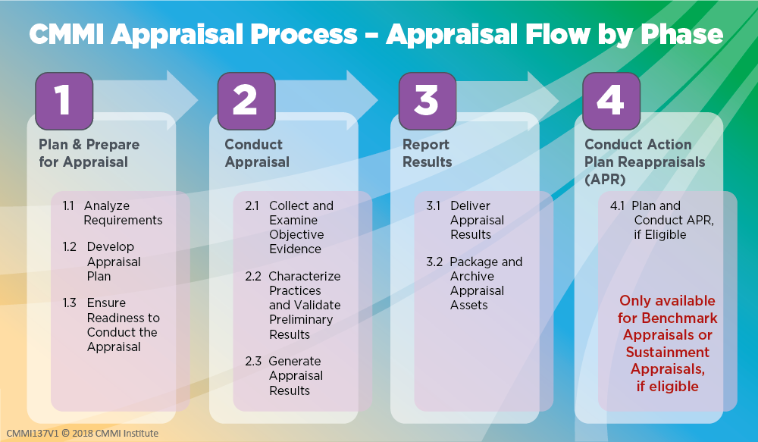

Slide 19
Findings Definitions – Required Categories
Required Findings Categories:
Weaknesses - A type of preliminary or final finding, which is an ineffective, or lack of implementation of one or more processes that meet the intent and value of a practice based on verified objective evidence, and applicable across the project(s) and organizational support functions or Organizational Unit as a whole. This is realized either by a) the process itself does not address a CMMI practice requirement, or b) the project(s) or organizational support functions are not following their process that IS compliant with the intent and value of the applicable CMMI practice.
Strengths - A type of preliminary or final finding, which is an exemplary or noteworthy implementation of a process that meets the intent and value of a CMMI model practice.
所需结果类别：
弱项——一种初步或最终的发现，是指一个或多个过程实施无效或缺乏实施，这些过程基于已验证的客观证据，符合实践的意图和价值，适用于整个项目和组织支持职能组或组织单元。这可以通过以下两种方式实现：a）过程本身没有满足CMMI实践需求，或者b）项目或组织支持职能组没有遵循符合适用CMMI实践意图和价值的过程。
强项——一种初步或最终的发现，是一个模范性或值得注意的过程实现，其符合CMMI模型实践的意图和价值。

Slide 20
Practice Area Findings 实践域发现

Slide 21

Causal Analysis and Resolution (CAR) 原因分析与解决
Intent: Identify causes of selected outcomes and take action to either prevent recurrence of undesirable outcomes or ensure recurrence of positive outcomes. 识别选定结果的原因并采取行动，防止不想要的结果再次发生或确保再次出现正面结果。
Value: Addressing root cause issues eliminates rework and directly improves quality and productivity. 解决根本原因问题可以消除返工并直接提高质量和生产率。
Strengths 强项:
None 没有
Weaknesses 弱项:
In some cases, the organizational guidelines and criteria for selecting CAR methods require more content. (3.2) 在某些情况下，用于选择CAR方法的组织指南和标准需要更多内容。
In some cases, the required resources, including people and funding, are inadequately provided to address root cause actions. (3.3) 在某些情况下，无法提供所需的资源（包括人员和资金）来解决根本原因行动。

Slide 22

Configuration Management (CM) 配置管理
Intent: Manage the integrity of work products using configuration identification, version control, change control, and audits. 使用配置识别、版本控制、变更控制和审计来管理工作产品的完整性。
Value: Reduces loss of work and increases the ability to deliver the correct version of the solution to the customer. 减少工作损失，并增加向客户提供正确版本解决方案的能力。
Strengths 强项:
A good CCB structure representative of management and staff has been established to manage changes to baselines and releases. 公司建立了代表管理层和员工的CCB，以管理对基线和发布的更改。
Weaknesses 弱项:
None 没有

Slide 23

Decision Analysis and Resolution (DAR) 决策分析与解决
Intent: Make and record decisions using a recorded process that analyzes alternatives. 使用分析备选方案的已记录过程做出并记录决策。
Value: Increases the objectivity of decision making and the probability of selecting the optimal solution. 增加决策的客观性和提高找到最佳解决方案的概率
Strengths 强项:
Where appropriate, alternative solutions are solicited from affected stakeholders through "brain-storming" sessions. 在适当的情况下，通过“头脑风暴”会议从受影响的利益相关者那里寻求替代解决方案。
The Corporate Management system defines authority levels and decision-making per role. 企业管理部定义了每个角色的权限级别和决策。
Weaknesses 弱项:
None 没有

Slide 24

Estimating (EST) 估算
Intent: Estimate the size, effort, duration, and cost of the work and resources needed to develop, acquire, or deliver the solution. 估算开发、采购或交付解决方案所需的工作和资源的规模、工作量、周期和成本。
Value: Estimation provides a basis for making commitments, planning, and reducing uncertainty, which allows for early corrective actions and increases the likelihood of meeting objectives. 估算为做出承诺、策划和减少不确定性提供了依据，有助于尽早采取纠正措施并提高实现目标的可能性。
Strengths 强项:
Well-defined estimates are used to allow work tracking and timely corrective actions to deliver solutions which meet QPPOs. 明确的定义了估算值可用于跟踪工作并及时采取纠正措施，以提供满足QPPO要求的解决方案。
Weaknesses 弱项:
None 没有

Slide 25

Governance (GOV) 管治
Intent: Provides guidance to senior management on their role in the sponsorship and governance of process activities. 指导高级管理层履行其在支持和治理过程活动中的职责
Value: Minimizes the cost of process implementation, increases the likelihood of meeting objectives, and ensures that the implemented processes support and contribute to the success of the business. 最大限度地降低过程实施成本，提高实现目标的可能性，并确保实施的过程支持并促成业务成功。
Strengths 强项:
None 没有
Weaknesses 弱项:
None 没有

Slide 26

Implementation Infrastructure (II) 实施基础条件
Intent: Ensure that the processes important to an organization are persistently and habitually used and improved. 确保组织重要过程得到一致和熟练的运用和改进。
Value: Sustains the ability to consistently achieve goals and objectives efficiently and effectively. 维持有效和高效地实现目标的能力。
Strengths 强项:
None 没有
Weaknesses 弱项:
In some cases, inadequate induction training is provided. (Engineering - 2.1) 在某些情况下，上岗培训不足。
Some project managers have a weak understanding of the use of statistical and quantitative techniques to manage their projects towards achieving the business QPPOs. (Project Management - 2.1) 一些项目经理对使用统计和定量技术来管理他们的项目以实现业务QPPO缺乏了解。

Slide 27

Managing Performance and Measurement (MPM) 管理绩效与度量
Intent: Manage performance using measurement and analysis to achieve business objectives. 使用度量和分析来管理性能，以实现业务目标。
Value: Maximizes business return on investment by focusing management and improvement efforts on cost, schedule, and quality performance. 将管理和改进工作集中在成本、进度和质量性能上，最大限度地提高业务投资回报。
Strengths 强项:
None 没有

Slide 28
Managing Performance and Measurement (MPM) 管理绩效与度量
Intent: Manage performance using measurement and analysis to achieve business objectives. 使用度量和分析来管理性能，以实现业务目标。
Value: Maximizes business return on investment by focusing management and improvement efforts on cost, schedule, and quality performance. 将管理和改进工作集中在成本、进度和质量性能上，最大限度地提高业务投资回报。
Weaknesses 弱项:
In some cases QPPOs are not clearly traceable to all business, performance and/or measurement objectives. (4.1) 在某些情况下，不能明确将QPPO追溯到所有业务，绩效和/或度量目标。
Although many prediction models have been developed, some are not updated. (4.4) 尽管已开发了许多预测模型，但其中一些模型尚未更新。

Slide 29

Monitor and Control (MC) 监控
Intent: Provide an understanding of the project progress so appropriate corrective actions can be taken when performance deviates significantly from plans. 提供对项目进度的掌握，以便在绩效显著偏离计划时采取适当的纠正措施。
Value: Increases the probability of meeting objectives by taking early actions to adjust for significant performance deviations. 通过及早采取行动调整显著绩效偏差，提高达成目标的可能性。
Strengths 强项:
Project Managers and Quality Assurance oversee and give assurance to effective stakeholder involvement during the project's lifecycle. 项目经理和质量保证监督并保证利益相关者在项目生命周期中的有效参与。
Weaknesses 弱项:
Some aspects of monitor and control reports were incomplete. (1.1) 监控报告的某些方面不完整。

Slide 30

Organizational Training (OT) 组织级培训
Intent: Develop the skills and knowledge of personnel so they perform their roles efficiently and effectively. 培养人员的技能和知识，以便他们高效且有效地执行他们的角色。
Value: Enhances individuals’ skills and knowledge to improve organizational work performance. 增强个人的技能和知识，提高组织工作性能。
Strengths 强项:
A comprehensive strategic training plan in support of business objectives has been established, maintained and executed. 已经建立，维护和执行了支持业务目标的全面战略培训计划。
Instructor training evaluations are well defined and performed to establish and maintain the organisation's training capability and ensure continuous improvement. 良好地定义和执行讲师培训评估，以建立和维护组织的培训能力并确保持续改进。
Weaknesses 弱项:
None 没有

Slide 31

Peer Reviews (PR) 同行评审
Intent: Identify and address work product issues through reviews by the producer’s peers or Subject Matter Experts (SMEs). 通过生产者同行或主题专家(SME)的评审来识别并解决工作产品的问题。
Value: Reduce cost and rework by uncovering issues or defects early. 及早发现问题或缺陷，降低成本和返工。
Strengths 强项:
None 没有
Weaknesses 弱项:
Not all available data from peer review results are analyzed sufficiently. (3.1) 并非对同行评审结果中的所有可用数据都进行了充分的分析。

Slide 32

Planning (PLAN) 策划
Intent: Develop plans to describe what is needed to accomplish the work within the standards and constraints of the organization 制定计划来描述在组织的标准和约束条件内完成工作所需的内容
Value: Optimizes cost, functionality, and quality to increase the likelihood that objectives will be met. 优化成本、功能和质量以增加实现目标的可能性。
Strengths 强项:
None 没有
Weaknesses 弱项:
In some projects, the follow-up reviews were incomplete. (2.8) 在某些项目中，后续审查不完整。

Slide 33

Process Asset Development (PAD) 过程资产开发
Intent: Develop and keep updated the process assets necessary to perform the work. 开发并保持更新执行工作所需的过程资产。
Value: Provides a capability to understand and repeat successful performance. 提供了解和重复成功性能的能力
Strengths 强项:
Standard process tailoring guideline descriptions are comprehensive. 标准过程裁剪指南描述非常全面。
Work environment standards are well defined for usage. 工作环境标准已明确定义以供使用。
Weaknesses 弱项:
The architecture was basic and not comprehensive. (3.2) 体系结构是基本的，并不全面。

Slide 34

Process Management (PCM) 过程管理
Intent: Manages and implements the continuous improvement of processes and infrastructure to support accomplishing business objectives, identify and implement the most beneficial process improvements, and make the results of process improvement visible, accessible, and sustainable. 管理和实施过程和基础条件的持续改进来、支持业务目标的实现、确定和实施能够带来最大效益的过程改进、使过程改进结果可见、可使用和可持续
Value: Ensures that processes, infrastructure, and their improvement contribute to successfully meeting business objectives. 确保过程、基础条件及其环境有助于成功实现业务目标。
Strengths 强项:
Good deployment planning practices are observed. 遵守了良好的部署计划实践。
Process improvement actions are well defined. 过程改进措施已明确定义。
Links between business objectives that are traced to process improvement objectives are well documented. 很好地记录了可追溯到过程改进目标和业务目标之间的链接。

Slide 35
Process Management (PCM) 过程管理
Intent: Manages and implements the continuous improvement of processes and infrastructure to support accomplishing business objectives, identify and implement the most beneficial process improvements, and make the results of process improvement visible, accessible, and sustainable. 管理和实施过程和基础条件的持续改进来、支持业务目标的实现、确定和实施能够带来最大效益的过程改进、使过程改进结果可见、可使用和可持续
Value: Ensures that processes, infrastructure, and their improvement contribute to successfully meeting business objectives. 确保过程、基础条件及其环境有助于成功实现业务目标。
Weaknesses 弱项:
None 没有

Slide 36

Process Quality Assurance (PQA) 过程质量保证
Intent: Verify and enable improvement of the quality of the performed processes and resulting work products. 验证并改进已执行的过程和所产生的工作产品的质量。
Value: Increases the consistent use and improvement of the processes to maximize business benefit and customer satisfaction. 增强过程使用和改进的一致性，以最大限度地提高业务效益和客户满意度。
Strengths 强项:
A comprehensive set of work products has been developed and is applied by process quality assurance. 公司开发了一套完整的工作产品，并应用于质量保证。
Weaknesses 弱项:
None 没有

Slide 37

Product Integration (PI) 产品集成
Intent: Integrate and deliver the solution that addresses functionality and quality requirements. 集成并交付满足功能和质量需求的解决方案。
Value: Increases customers’ satisfaction by giving them a solution that meets or exceeds their functionality and quality requirements. 通过提供达到或超过其功能和质量要求的解决方案来提高客户的满意度。
Strengths 强项:
A very good understanding and execution of the product integration strategy is demonstrated. 公司展示了对产品集成策略的很好的理解和执行。
Weaknesses 弱项:
None 没有

Slide 38

Requirements Development and Management (RDM) 需求开发与管理
Intent: Elicit requirements, ensure common understanding by stakeholders, and align requirements, plans, and work products. 导出需求，确保干系人取得一致理解，并调整需求、计划和工作产品。
Value: Ensures that customers’ needs and expectations are satisfied. 确保客户的需求和期望得到满足。
Strengths 强项:
None 没有
Weaknesses 弱项:
None 没有

Slide 39

Risk and Opportunity Management (RSK) 风险与机会管理
Intent: Identify, record, analyze, and manage potential risks or opportunities. 识别、记录、分析和管理潜在的风险或机会。
Value: Mitigate adverse impacts or capitalize on positive impacts to increase the likelihood of meeting objectives. 缓解不利影响或充分利用积极影响来提高实现目标的可能性。
Strengths 强项:
None 没有
Weaknesses 弱项:
Certain risk management plans did not incorporate information specific to strategy which is used to guide the risk and management activities. (3.3) 某些风险和管理计划未包含特定用于指导风险和管理活动的策略信息。
Risk management is effective. However opportunity management activities are not clearly defined to ensure effective implementation. (3.5) 风险管理是有效的。 但是，没有明确定义机会管理活动以确保有效实施。

Slide 40

Technical Solution (TS) 技术解决方案
Intent: Design and build solutions that meet customer requirements. 设计和构建满足客户需求的解决方案。
Value: Provides a cost-effective design and solution that meets customer requirements and reduces rework. 提供高效的设计和解决方案，以满足客户需求并且减少返工。
Strengths 强项:
Good use is made of industry best practice design methods and techniques. 充分利用了行业最佳实践的设计方法和技术。
Weaknesses 弱项:
None 没有

Slide 41

Verification and Validation (VV) 验证与确认
Intent: Verification and validation includes activities that confirm selected solutions and components meet their requirements, and validate selected solutions and components fulfill their intended use in their target environment. 验证和确认包括以下活动、确认选定的解决方案和组件是否满足需求、证明选定的解决方案和组件在目标环境下是否能实现其预期用途
Value: Verification and validation of selected solutions and components throughout the project increases the likelihood that the solution will satisfy the customer. 在整个项目过程中对选定的解决方案和组件进行验证和确认可以提高解决方案满足客户需求的可能性。
Strengths 强项:
None 没有
Weaknesses弱点:
None 没有

Slide 42
Performance Report 性能报告

Slide 43
Practice Area Findings 实践域发现

Slide 44
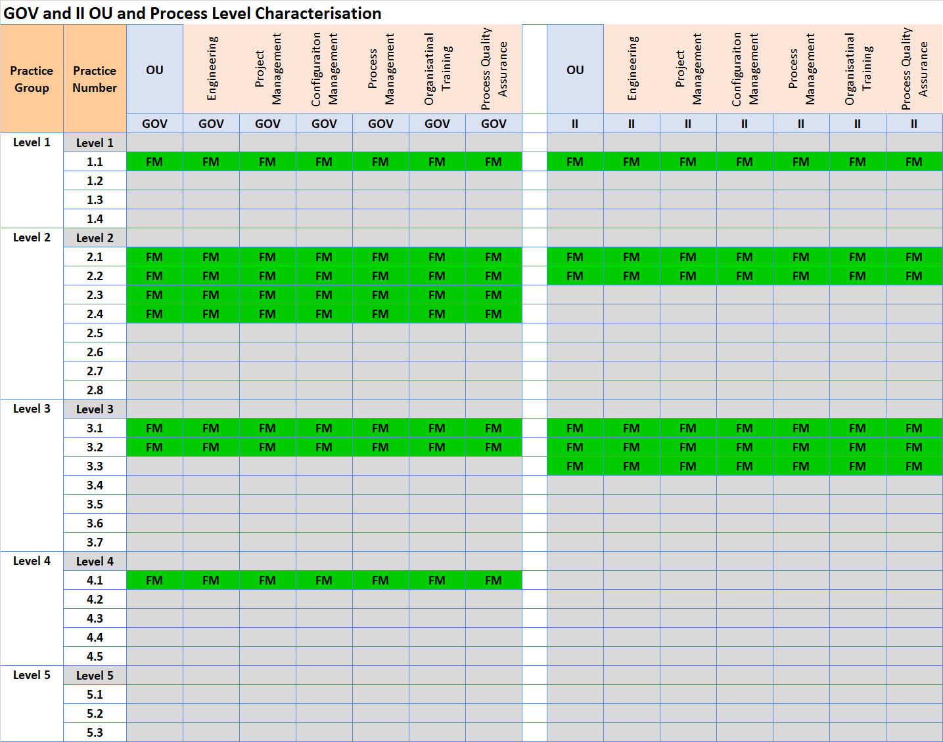
Ratings for
Notes:
For each practice, enter the OU-Level characterization (FM, LM, PM, DM, NY). The chart will set a color.
Based on the characterizations of all practices in each practice level, set the Practice Level rating to “S” (Satisfied) or “U” (Unsatisfied).
The PA Rating is the Highest Practice Level at which all practices for it, and all lower Practice Levels, are Satisfied.
For details, see the MDD, Activity 2.3.2 Determine Practice Group Ratings, and Activity 2.3.3 Determine Practice Area and Maturity Level or Capability Level Profile Rating.

Slide 45
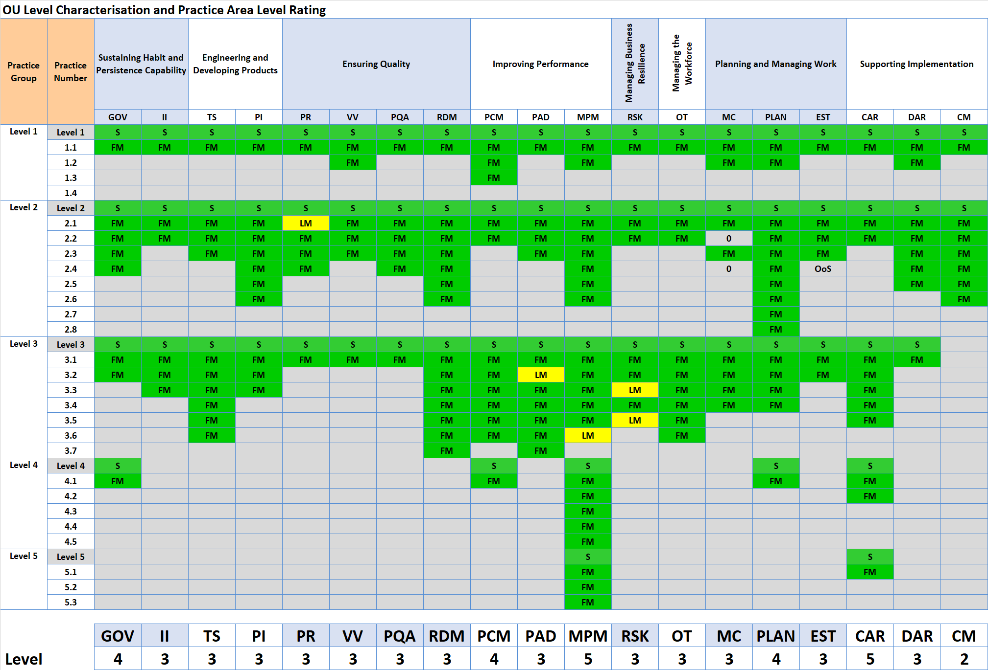
Ratings for
Notes:
For each practice, enter the OU-Level characterization (FM, LM, PM, DM, NY). The chart will set a color.
Based on the characterizations of all practices in each practice level, set the Practice Level rating to “S” (Satisfied) or “U” (Unsatisfied).
The PA Rating is the Highest Practice Level at which all practices for it, and all lower Practice Levels, are Satisfied.
For details, see the MDD, Activity 2.3.2 Determine Practice Group Ratings, and Activity 2.3.3 Determine Practice Area and Maturity Level or Capability Level Profile Rating.

Slide 46
Congratulations!
On being rated
Maturity Level 5
恭喜贵公司顺利通过CMMI成熟度5级评估
Note: 注：
Before the results of this appraisal become public record, e.g., announced in a press release or on an organization’s public Web site, or used in response to a request for proposal, the appraisal must first be accepted by the ISACA CMMI quality team.
在评估结果正式公开之前，例如在新闻稿或公司官网上公开，或将其用于响应请求建议书之前，该评估须首先被ISACA CMMI 质量团队认可
This can take up to 8 weeks from the time that the appraisal results are submitted to the ISACA CMMI quality team for review. Results are submitted to the ISACA CMMI quality team typically within 4-6 working days after the final findings presentation has been made.
从将评估结果提交给ISACA CMMI质量团队起，最长可能需要8周进行审核。通常在完成最终发现展示后的4-6个工作日内，评估结果会提交给ISACA CMMI质量团队。

Slide 47
Ratings 評級

Slide 48
Appraisal Team Affirmations – Signature Page
I support the findings in this presentation and affirm that to the best of my knowledge it represents an accurate portrayal of the state of the process in the appraised organization. 我支持本报告中的发现结果，并确认以上发现准确地描述了被评估组织的过程状态。

Slide 49
Annexures 附加展示

Slide 50
Non model findings

Slide 51
Non model findings

Slide 52
Findings Definitions – Optional Findings Categories
Notes – additional explanatory information regarding weaknesses or strengths, e.g., examples, supporting indicators, and consequences resulting from weaknesses. Notes must NOT be used as a category in lieu of weaknesses.
Improvement Opportunities – A type of preliminary or final finding about a particular practice area or practice which is typically compliant with the CMMI but represents an opportunity where the process could be improved.
Improvements in Progress – A type of preliminary or final finding statement that is a reflection of the current state of a practice area or practice which is newly implemented for the project(s) or Organizational Unit and shows promise of helping to achieve further improvement. Due to the recent nature of that process implementation, artifacts may be limited.
Recommendations/Next Steps – Recommendations by the appraisal team for ways to address findings. These must not be conveyed as mandatory or guarantees of future characterizations or ratings. Recommendations must be either a separate report or separate section from the main appraisal findings, including the ratings and a disclaimer that “These recommendations are not mandatory nor guarantee of addressing findings or future characterizations or ratings.”

Slide 53
Improvement Opportunities
CAR 2.1 - Consider also using opportunity data as outcomes for further analysis. 考虑将机会数据用作进一步分析的结果。
CAR 3.4 - Consider reviewing causes and applying appropriate causal analysis methods for specific outcomes, such as fishbone for the common cause of variation vs 5-why for special cause of variation 考虑对原因进行审查并针对特定结果应用适当的因果分析方法，例如，将鱼骨用于公共原因偏差，而对于特殊原因偏差则使用5个why.。
DAR 2.1 - Consider expanding DAR's use across different process areas by informing stakeholders when a criteria-based decision-making process could be beneficial. 考虑将DAR的用途扩展到不同的过程领域，在基于标准的决策过程有益处时，通知相关的干系人。
II 3.3 - Consider providing a centralised portal through which all process improvement suggestions can be registered. 考虑提供一个集中式门户，通过该门户可以提交所有过程改进建议。
MPM 3.6 - Consideration should be given to establish a public dashboard where measurement results are displayed. 应该考虑建立一个公共板面来显示度量结果。
MPM 4.2 - Consider expanding and maturing the measurement practices by adopting a technique such as GQIM (Goal Question Indicator Metric). 考虑采用诸如GQIM（目标问题指标度量）之类的技术来扩展和完善度量实践。

Slide 54
Improvement Opportunities - continued
PLAN 2.1 - Consider conducting research and feasibility into following another development approach, such as SCRUM Agile. 考虑进行另一种开发方法，例如SCRUM Agile的可行性研究。
PR 2.1 - Consider using more of the available peer review data to identify potential improvement opportunities. 考虑使用更多可用的同行评审数据来识别潜在的改进机会。
RSK 2.1 - The analysis of opportunities should consider their leverage by assigning the highest priority for those with the greatest benefits. 机会分析应考虑为收益最大的机会分配最高优先级。
RSK 2.2 - Consider reviewing risks or opportunities periodically, including changing conditions, in order to uncover risks or opportunities which were previously overlooked or did not exist when identification & priorities were last updated. 考虑定期检查风险或机会，包括变化的条件，以发现在上一次识别和制定优先级被忽略或不存在的风险或机会。
RSK 3.3 - Consider a systematic approach to risk or opportunity management which avoids problems and leverages opportunities to increase the likelihood of achieving business objectives and meeting QPPOs. 考虑一种风险或机会管理的系统方法，该方法可以避免问题并利用机会来增加实现业务目标和满足QPPO的可能性。

Slide 55
Next steps

Slide 56
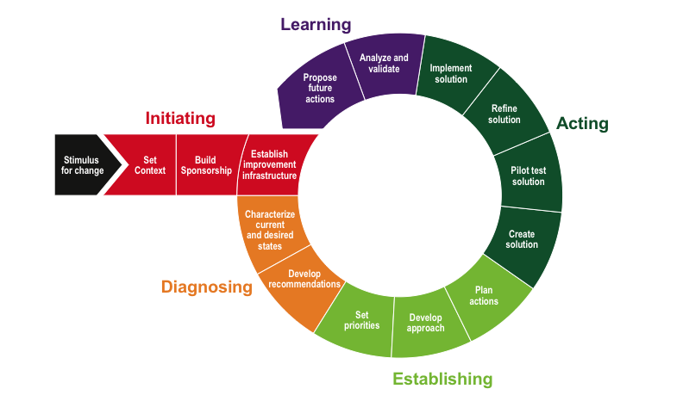
Re-appraisal
Continuous improvement over next 3 years
Re appraise
The IDEAL Model

Slide 57
CERTIFICATE

Slide 58
Notice
This pptx has embedded links to 00_Data_Reference.xlsm
The latest information and version of the Benchmark Appraiser Support Environment (BASE) can be accessed at www.demix.org/tools

Slide 59
Agenda
Appraisal Overview 评估概述
Practice Area Findings 实践域发现
Performance Report 性能报告
Ratings 評級
Annexures 附加展示
Non model findings
Improvement opportunities
Next steps

